Slide 1
ARTIFICIAL INTELLIGENCE (KNOWLEDGE REPRESENTATION)
Crash Course in AI and expert system by Louis E. Frenzel
Chapter 2

Slide 2
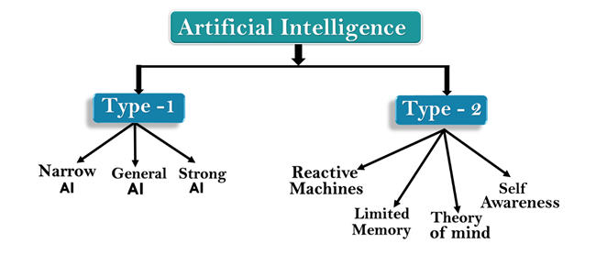
TYPES OF ARTIFICIAL INTELLIGENCE:
9/11/2023
Artificial Intelligence can be divided in various types, which are based on capabilities and based on functionally of AI.
Rahman Ali, Lecturer in Comp. Science, Quaid-e-Azam College of Commerce, University of Peshawar
2

Slide 3
AI TYPE-1: BASED ON CAPABILITIES
9/11/2023
Weak AI or Narrow AI
Narrow AI is a type of AI which is able to perform a dedicated task with intelligence.The most common and currently available AI is Narrow AI in the world of Artificial Intelligence.
Narrow AI cannot perform beyond its field or limitations, as it is only trained for one specific task. Hence it is also termed as weak AI. Narrow AI can fail in unpredictable ways if it goes beyond its limits.
Apple Siriis a good example of Narrow AI, but it operates with a limited pre-defined range of functions.
IBM's Watson supercomputer also comes under Narrow AI, as it uses an Expert system approach combined with Machine learning and natural language processing.
Some Examples of Narrow AI are playing chess, purchasing suggestions on e-commerce site, self-driving cars, speech recognition, and image recognition.
Rahman Ali, Lecturer in Comp. Science, Quaid-e-Azam College of Commerce, University of Peshawar
3

Slide 4
GENERAL AI:
9/11/2023
General AI is a type of intelligence which could perform any intellectual task with efficiency like a human.
The idea behind the general AI to make such a system which could be smarter and think like a human by its own.
Currently, there is no such system exist which could come under general AI and can perform any task as perfect as a human.
The worldwide researchers are now focused on developing machines with General AI.
As systems with general AI are still under research, and it will take lots of efforts and time to develop such systems.
Rahman Ali, Lecturer in Comp. Science, Quaid-e-Azam College of Commerce, University of Peshawar
4

Slide 5
SUPER AI:
9/11/2023
Super AI is a level of Intelligence of Systems at which machines could surpass human intelligence, and can perform any task better than human with cognitive properties. It is an outcome of general AI.
Some key characteristics of strong AI include capability include the ability to think, to reason,solve the puzzle, make judgments, plan, learn, and communicate by its own.
Super AI is still a hypothetical concept of Artificial Intelligence. Development of such systems in real is still world changing task.
Rahman Ali, Lecturer in Comp. Science, Quaid-e-Azam College of Commerce, University of Peshawar
5

Slide 6
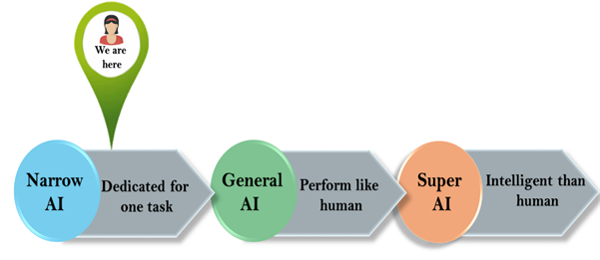
9/11/2023
Rahman Ali, Lecturer in Comp. Science, Quaid-e-Azam College of Commerce, University of Peshawar
6

Slide 7
ARTIFICIAL INTELLIGENCE TYPE-2: BASED ON FUNCTIONALITY
Reactive Machines
Purely reactive machines are the most basic types of Artificial Intelligence.
Such AI systems do not store memories or past experiences for future actions.
These machines only focus on current scenarios and react on it as per possible best action.
Google's AlphaGo is also an example of reactive machines.
AlphaGo is a computer program developed by DeepMind, a subsidiary of Google. It gained significant attention in 2016 when it defeated the world champion Go player, Lee Sedol, in a five-game match. AlphaGo uses deep neural networks and machine learning techniques to play the ancient board game of Go at a highly advanced level
9/11/2023
Rahman Ali, Lecturer in Comp. Science, Quaid-e-Azam College of Commerce, University of Peshawar
7

Slide 8
LIMITED MEMORY
9/11/2023
Limited memory machines can store past experiences or some data for a short period of time.
These machines can use stored data for a limited time period only.
Self-driving cars are one of the best examples of Limited Memory systems. These cars can store recent speed of nearby cars, the distance of other cars, speed limit, and other information to navigate the road.
Rahman Ali, Lecturer in Comp. Science, Quaid-e-Azam College of Commerce, University of Peshawar
8

Slide 9
THEORY OF MIND
9/11/2023
Theory of Mind AI should understand the human emotions, people, beliefs, and be able to interact socially like humans.
This type of AI machines are still not developed, but researchers are making lots of efforts and improvement for developing such AI machines.
Rahman Ali, Lecturer in Comp. Science, Quaid-e-Azam College of Commerce, University of Peshawar
9

Slide 10
SELF-AWARENESS
9/11/2023
Self-awareness AI is the future of Artificial Intelligence. These machines will be super intelligent, and will have their own consciousness, sentiments, and self-awareness.
These machines will be smarter than human mind.
Self-Awareness AI does not exist in reality still and it is a hypothetical concept.
Rahman Ali, Lecturer in Comp. Science, Quaid-e-Azam College of Commerce, University of Peshawar
10

Slide 11
AGENTS IN ARTIFICIAL INTELLIGENCE
9/11/2023
An AI system can be defined as the study of the rational agent and its environment. The agents sense the environment through sensors and act on their environment through actuators. An AI agent can have mental properties such as knowledge, belief, intention, etc.
Rahman Ali, Lecturer in Comp. Science, Quaid-e-Azam College of Commerce, University of Peshawar
11

Slide 12
WHAT IS AN AGENT?
9/11/2023
An agent can be anything that perceiveits environment through sensors and act upon that environment through actuators. An Agent runs in the cycle of perceiving, thinking, and acting. An agent can be:
Human-Agent: A human agent has eyes, ears, and other organs which work for sensors and hand, legs, vocal tract work for actuators.
Robotic Agent: A robotic agent can have cameras, infrared range finder, NLP for sensors and various motors for actuators.
Software Agent: Software agent can have keystrokes, file contents as sensory input and act on those inputs and display output on the screen.
Hence the world around us is full of agents such as thermostat, cellphone, camera, and even we are also agents.
Rahman Ali, Lecturer in Comp. Science, Quaid-e-Azam College of Commerce, University of Peshawar
12

Slide 13
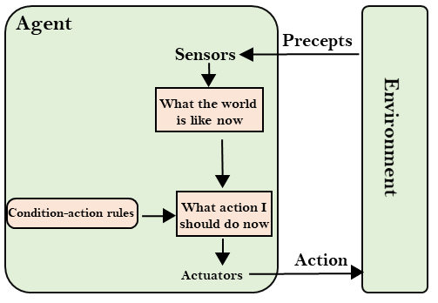
9/11/2023
Rahman Ali, Lecturer in Comp. Science, Quaid-e-Azam College of Commerce, University of Peshawar
13

Slide 14
ASSIGNMENT# 2
9/11/2023
What are the type of AI agents explain in detail.
Rahman Ali, Lecturer in Comp. Science, Quaid-e-Azam College of Commerce, University of Peshawar
14

Slide 15
WHAT YOU HAVE ALREADY LEARNT?
9/11/2023
What is intelligence?
What is artificial intelligence?
What is the difference between AI and conventional computing?
How to designate some software to be artificially intelligent?
What are the different applications of AI?
15

Slide 16
YOU ARE GOING TO LEARN…
Knowledge Representation
Knowledge base
Inference engine
Knowledge representation schemes
Declarative
Procedural
Logic-based system
Deductive reasoning
Inductive reasoning
Computational logic
Types of computational logic
Propositional logic
Predicate logic

Slide 17
KNOWLEDGE REPRESENTATION
9/11/2023
AI system = knowledge base + inference mechanism
Most of the time knowledge already exist in the form of human mind, books, articles etc.
Knowledge must be collected and codified
17

Slide 18
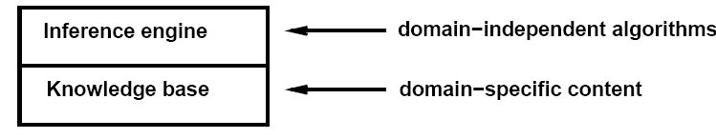
KNOWLEDGE REPRESENTATION
Knowledge Base: Set of sentences represented in a knowledge representation language and represents assertions about the world.
Inference rule: when one ASKs questions from the KB, the answer should follow from what has been TELLed (told) to the KB, previously.
KR schemes have two things in common, 1) being programmed in existing computer languages; 2) can be manipulated by inference system
ask
tell
Notes:
‹#›

Slide 19
KNOWLEDGE BASE
It contains facts, theories, concepts, practical procedures and the relationship between them
Knowledge is collected using the process called knowledge engineering
Knowledge base need some data structure to store the knowledge

Slide 20
INFERENCING MECHANISM
Is a set of procedures that are used to examine the knowledge base in an orderly manner to answer questions, solve problems, or make decisions within the domain
Uses searching and pattern matching

Slide 21
KNOWLEDGE REPRESENTATION SCHEMES
Mainly divided into
Declarative
Used to represent facts and assertions.
It includes:
logic based systems
semantic networks
frame-based systems
scripts
Procedural
Used to represent action and procedures.
It includes:
procedures/subroutines
Rules

Slide 22
LOGIC-BASED SYSTEM
Logic is considered to be a sub division of philosophy
It is the oldest model of knowledge representation
The general form of a logic process is shown in the following diagram
Inputs/premises /information Output inferences/conclusions
Logical process

Slide 23
LOGIC-BASED SYSTEM
There are two types of reasoning
Deductive reasoning/deduction
Inductive reasoning

Slide 24
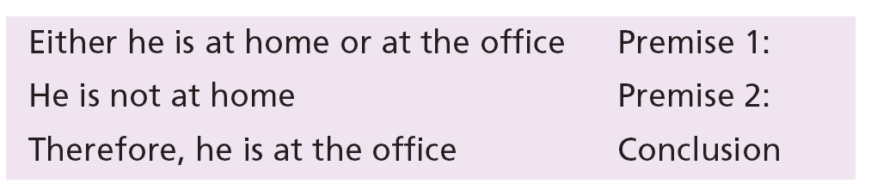
DEDUCTIVE REASONING
From general principal to specific conclusion
The general premises are used to obtain a specific inference
Consists of three parts
Major premise
e.g. I do not run when the temperature exceeds 30 degree
Minor premise
Today the temperature is 35 degree
Conclusion
Therefore, I will not run today
Also consider the following example

Slide 25
INDUCTIVE REASONING
From specific and established facts to general conclusion
Example:
Premise:
A defective hard disk results in failure of opening documents data
Premise:
A scratched DVD results in failure of playing the video
Conclusion:
A faulty storage device may results in a failure of retrieving of data
The conclusion is never final or absolute >> may change with new discovery
There is always an uncertainty >> unless all facts are included→ not possible
The more knowledge you have, the more conclusive your inference can be

Slide 26
COMPUTATIONAL LOGIC
In order to apply deductive/inductive reasoning to be manipulated by computer, the result is symbolic or mathematical logic.
It is the system of rules and procedures that permit the drawing of inferences from various premises using a variety of logical techniques called computational logic
The process of performing reasoning using logic methods is generally called computational logic
Notes:
For a computer to perform reasoning using logic, some method must be used to convert syllogisms and the deductive or inductive reasoning into a form suitable for manipulation by a computer. The result is what is known as symbolic logic or mathematical logic. It is a system of rules and procedures that permit the drawing of inferences from various premises using a variety of logical techniques. These methods are generally known as computational logic.
‹#›

Slide 27
TYPES OF COMPUTATIONAL LOGIC
Propositional logic (calculus)
Predicate logic (calculus)

Slide 28
PROPOSITIONAL CALCULUS
Proposition
A proposition is an assertion or premises or statement which is either true or false.
They are usually represented by symbols i.e.
A= Today is raining
B= Aslam will not come
Proposition logic
Propositional logic is a language made up from a set of sentences that can be used to carry out logical reasoning about the world.

Slide 29
PREPOSITIONAL CALCULUS
Types of propositions
Simple proposition
Which consists of only one proposition
Example
A = The postman comes Monday to Saturday
B= Today is Sunday
C=The postman will not come today
Complex proposition
Which consists of multiple proposition connected through logical operators
Logical operators are
AND(&^U), OR(+Uv), NOT(~), IMPLIES(→), EQUIVALENT(≡)
Example
D= the car is black
E= the car has a 6 cylinder engine
C= D & E

Slide 30
PROPOSITIONAL LOGIC: SYNTAX I
Vocabulary
A set of propositional symbols
P, Q, R, ….
A set of logical connectives
∧, ∨ , ¬ , ⇒, ⇔
∧ (and) ∨ (or) ¬(not) ⇒ (implication) ⇔ (equivalence)
Parenthesis (for grouping)
( )
Logical constants
True, False

Slide 31
SAMPLE SENTENCES IN PROPOSITIONAL LOGIC
P (P ∧ ¬ Q) ⇒ R
True (P ∧ Q) ⇔ (Q ∧ P)
(P ∧ Q) (P ∨ R )
What do the sentences mean?
The meaning depends on user defined semantics. If P is defined as “it is hot” and Q is defined as “it is raining”, then
P means it is hot
P ∨ Q means either it is hot or it is raining (or both)
¬Q means that it is not raining

Slide 32
The following are sentences in propositional language:
Today is Sunday (S).
It is raining (R).
Today is Sunday or Monday (S ∨ M).
It is not raining (¬ R).
Notes:
‹#›

Slide 33
EXAMPLE: PROPOSITIONAL CALCULUS
If it is sunny today, then the sun shines on the screen. If the sun shines on the screen, the blinds are brought down. The blinds are not down.
Is it sunny today?
P: It is sunny today.
Q: The sun shines on the screen.
R: The blinds are down.
Premises: P→Q, Q→R, ¬R
Conclusion: P

Slide 34
PREDICATE LOGIC (CALCULUS)
It is sophisticated than propositional but using the same concepts as that of the propositional logic
It adds more ability to propositional logic, that is, it divides the premises to parts and objects which makes the representation more easier
It also uses variables and functions which make it a powerful representation method

Slide 35
PREDICATE LOGIC (CALCULUS)
Each proposition is divided into two parts
Predicate or assertion
It would be the verb or part of the verb
Argument
It is the individual or object about which the assertion is made. It is noun
Its general form is
PREDICATE (ob1, ob2)
For example
the car is in the garage. It would be stated as
IN ( car, garage )
Ali is a friend of Jamal
FRIEND(Ali, Jamal)

Slide 36
9/11/2023
Father(x): unary predicate
Brother(x,y): binary predicate
Sum(x,y,z): ternary predicate
P(x,y,z,t): n-ary predicate
36

Slide 37
In predicate logic, a sentence is divided into a predicate and arguments. For example, each of the following propositions can be written as predicates with two arguments:
The relationship of motherhood in each of the above sentences is defined by the predicate mother. If the object Mary in both sentences refers to the same person, we can infer a new relation between Linda and Anne:
grandmother (Linda, Anne)
Notes:
‹#›

Slide 38
Example
The sentence “John works for Ann’s sister” can be written as: Works [John, sister(Ann)] in which the function sister(Ann) is used as an argument.
The sentence “John’s father calls Ann’s sister” can be written as: Calls[father(John), sister(Ann)]
Notes:
‹#›

Slide 39
Quantifiers
Predicate logic allows us to use quantifiers. Two quantifiers are common in predicate logic:
The first, which is read as “for all”, is called the universal quantifier: it states that something is true for every object that its variable represents.
The second, which is read as “there exists”, is called the existential quantifier: it states that something is true for one or more objects that its variable represents.
Notes:
‹#›

Slide 40


Example
1. The sentence “All men are mortals” can be written as:
2. The sentence “Frogs are green” can be written as:
3. The sentence “Some flowers are red” can be written as:
Notes:
‹#›

Slide 41
Example
Continued
4. The sentence “John has a book” can be written as:
5. The sentence “No frog is yellow” can be written as:
or
6. Every human being wants to be successful.
Notes:
‹#›

Slide 42
Notes:
‹#›

Slide 43
Example
9/11/2023
No one in this class is wearing Coat and Cap.
Domain of x is persons in this class
Coat(x): x is wearing coat
Cap(x): x is wearing a cap
¬∃x(Coat(x)∧Cap(x))
Domain of x is all persons
Class(x): x belongs to the class
¬∃x(Class(x)∧Coat(x)∧Cap(x))
43

Slide 44
Example
9/11/2023
Every computer science student must take a discrete mathematics course”.
Express the statement “Everybody must take a discrete mathematics course or be a computer science student”.
Let P(x) be the predicate “x must take a discrete mathematics course” and let Q(x) be the predicate “x is a computer science student”.
Express the statement “Every computer science student must take a discrete mathematics course”.
∀x(Q(x) → P(x))
44

Slide 45
9/11/2023
Express the statement “for every x and for every y, x + y > 10”
Let P(x, y) be the statement x + y > 10 where the universe of discourse for x, y is the set of integers.
Express the statement “for every x and for every y, x + y > 10”
Let P(x, y) be the statement x + y > 10 where the universe of discourse for x, y is the set of integers.
Answer: ∀x∀yP(x, y)
45

Slide 46
Examples
9/11/2023
1. ∃ x blue(x)
Some objects are blue"
There exist objects that are blue"
2. There is somebody who knows everyone
∃ x ∀ y K(x, y).
3. Everybody has somebody who is his or her mother
∀ y ∃ x M(x, y).
4. Nobody is perfect
¬∃ x P(x).
5. All dogs are mammals
∀ x(dog(x) → mammal(x)).
6. Some dogs are brown
This statement means that there are some animals that are dogs and that are brown
∃ x(dog(x) ∧ brown(x))
7. All new cars must be registered.
46
8. Some of the CS graduates graduate with honor.

Slide 47
All computer science students are smart.
9/11/2023
∀ x student(x) ∧ at (x,CS) → Smart(x)
For some humans failure is important, and for others success is important.
47

Slide 48
Deadline. : Handwritten
Assignment 2
9/11/2023
Some integers are not even
Not all integers are even
Some cars are not expensive
All integers are even
Some birds don't fly
A number is even only if it is integer
Tom is taller than John
All lions are fierce.
Some integers are even and some are odd
All Americans eat cheeseburgers.
No integer is even
Some lions do not drink coffee.
If an integer is not even, then it is odd
There is a person who helps everybody.
Someone at computer science is smart.
Everybody loves Raymond.
48
There is somebody whom no one helps

Slide 49
Reference
1- Louis. E. Prenzil. Jr, Crash course in Artificial Intelligence
and Expert System, Chapter No.2

